Slide 1
Rudy Shankar, Ph.D., MBA
Presented to:
Energy Systems Engineering Institute
Lehigh University
February 5 2016

Slide 2
Talk Outline
The US Grid and Evolution
Advances in Operations & Maintenance
Generation Resources & Pricing
Distributed Generation & Renewables
Reliable, Cheap, Clean and Appealing: Conflict
Way Forward

Slide 3
Background
“Embracing Disruption- Developing Leadership Role for Utilities”.
Public Utilities Fortnightly. January 2014.
“Correlation Processing– Big Data in Action”.
Public Utilities Fortnightly. February 2014.
“Wireless Sensor Networks- Equipment Health Monitoring for the Modern Utility”.
Public Utilities Fortnightly. July 2014

Slide 4
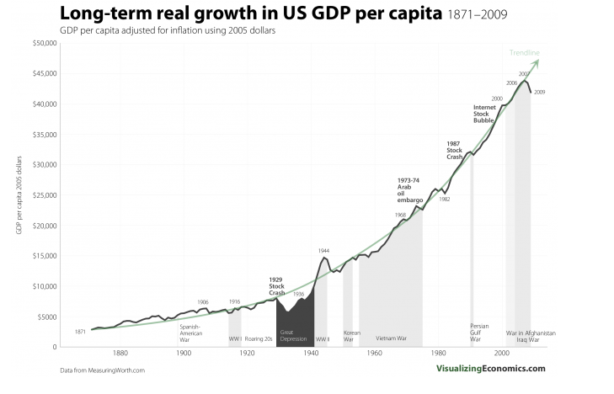
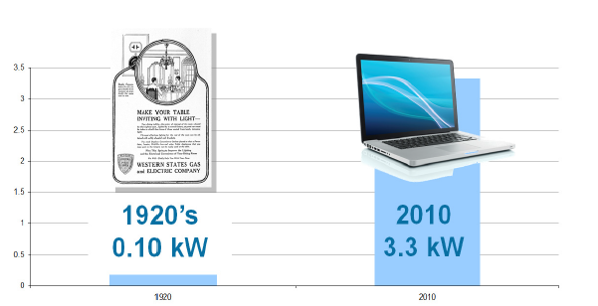
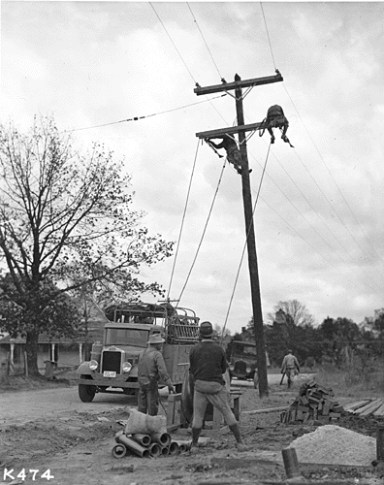
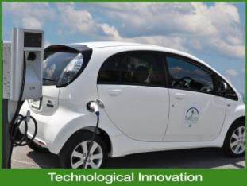

Slide 5




Results We Can See Today

Slide 6
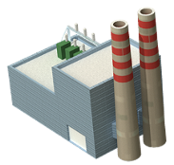



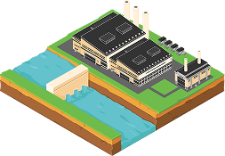

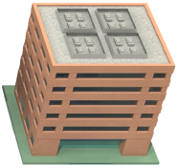
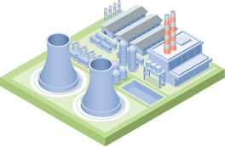

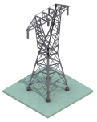
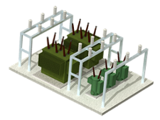
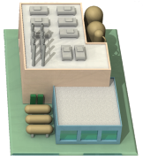
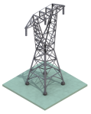
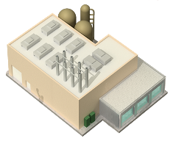
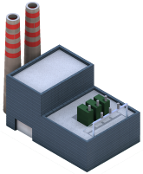
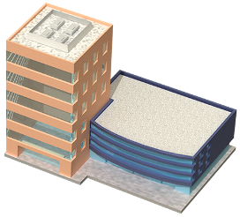




Yesterdays Power System
Generation
Delivery
Customer
Base Load
Generation
+
Load Following
Generation
+/–
Bulk Energy
Storage
=
Customer
Demand
–
Interruptible
Load DR
Courtesy: EPRI

Slide 7








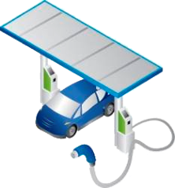
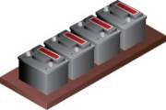
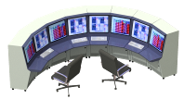
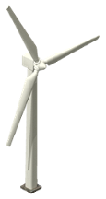



Transformation of the Power System
What will be the pace of change?
Courtesy:EPRI

Slide 8
Challenges to Utilities*
“Practicing Risk Aware Electricity Regulation”- A Ceres Report April 2012
Aging Fleet
Operations & Maintenance
Environmental regulations
Clean Power Plan EPA 111 (d)
Coal and gas prices
Smart Grid-Customer focus
Policy favoring distributed resources & new business models
Solar technology near grid parity in many States
Flat electricity growth
Financial metrics poor; junk bond status
Annual Growth Rate (%)

Slide 9
An Aging Coal Fleet
TVA’s Coal Plants vs. Neighbors
9

Slide 10
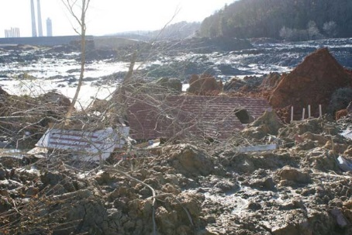
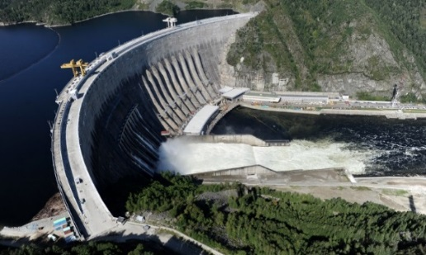
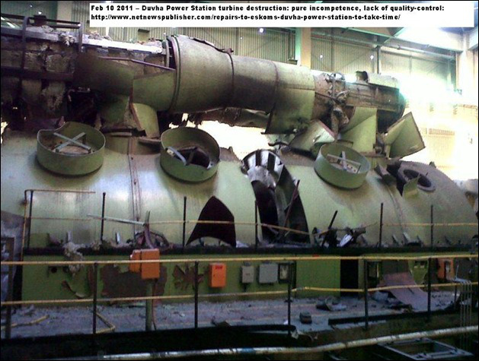
Example Failures *
Correlation Processing- Big Data at Work. Public Utilities Fortnightly. February 2014.
TVA Kingston coal ash spill 2008
Sayano Shushenskaya Accident - Russian Dam failure 2009 – widespread damage and loss of lives
Eskom Duvha Plant Turbine Burst 2011
TVA Kingston Coal Ash Spill 2008
Eskom Duvha Turbine Burst 2011

Slide 11
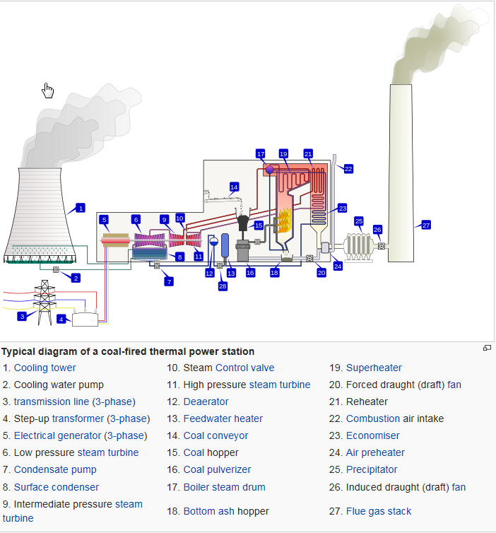
Sensors are the Game Changers
Equipment & Process conditions of many major systems are measured: flow, temp, pressure, etc. (DT > 1 sec )
New wireless sensors can perform on-demand or ubiquitous monitoring of dynamic components (DT < 1 msec )
Plant historians store these disparate data
Workhorse equipment-- 4KV motors driving coal pulverizers & feed pumps – can be monitored on as-needed basis
Wireless sensors avoid cabling > $3,000/ft.
Economics and accuracy

Slide 12
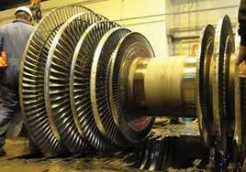
What is Smart Monitoring?
Trending
Detection and Diagnosis
Self Diagnosing and Alerting
Capability
Time

Slide 13
Remote Condition Monitoring
Web Accessible Fleet-Wide Metrics and Analysis
Diagnosis of impending failures well in advance
Determination of failure type (e.g. inner race defect on outboard bearing on Main Feed Pump)
Root cause of problem
(e.g. misalignment of motor to pump)
Estimated time to failure
Run to scheduled outage
Comparison of similar equipment
Data sharing with analysts and vendors

Slide 14
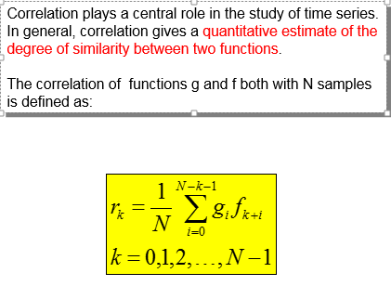

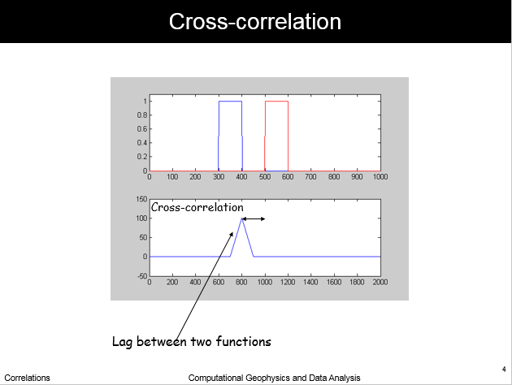
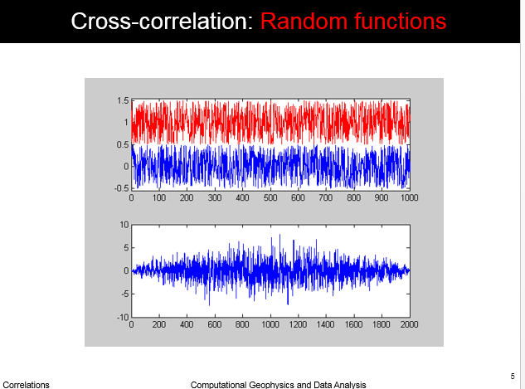
Correlation
The most reliable processing scheme to detect similarity

Slide 15
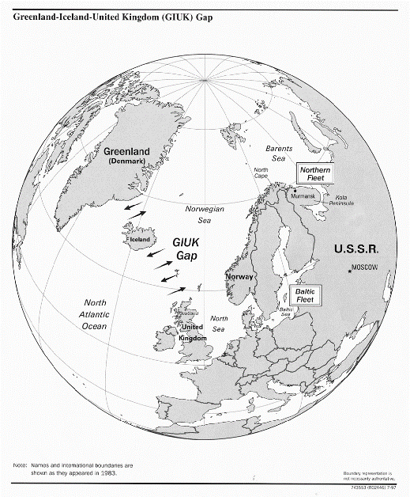
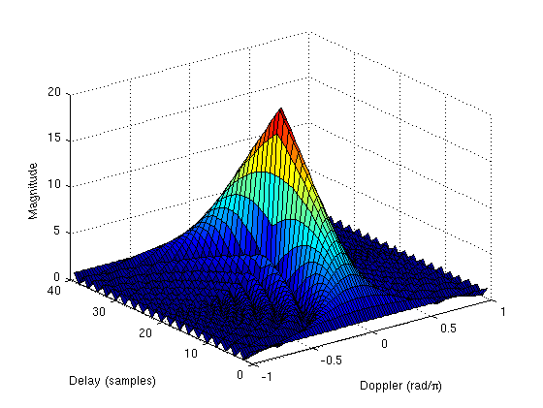

Correlation Processing
Radar and Sonar Processing
SOSUS array
  Primary defense against sea-borne threats
  Placed in the Atlantic and Pacific Oceans; Measures coherence for different time delays and Doppler shift
Airline In-flight Maintenance
  Anomalous Engine Condition

Slide 16
Power Plant Monitoring

Slide 17
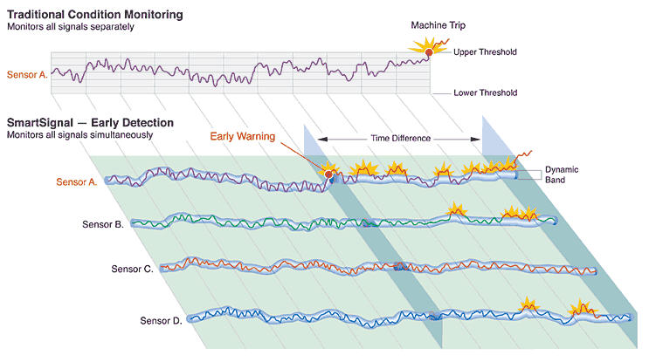
Enabling Technology
    Advanced pattern recognition (APR) techniques have been applied recently to tens of thousands of data points per fleet of power plants.
A
C
B
D
SENSORS
TIME
Time
Notes:
-What if you had a prediction curve available?
-This is done for tens of thousands of points near real-time, automatically
-Anomalies are automatically generated and brought to attention of M&D staff using alert/alarm format

Slide 18
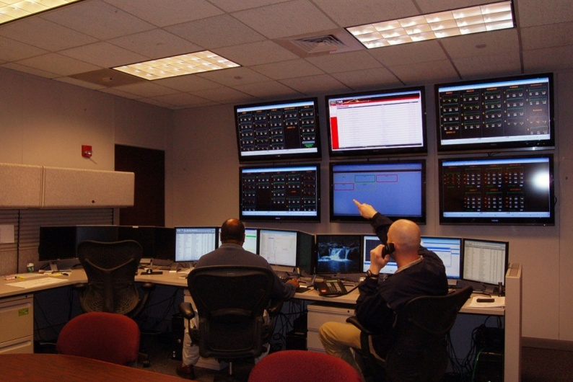
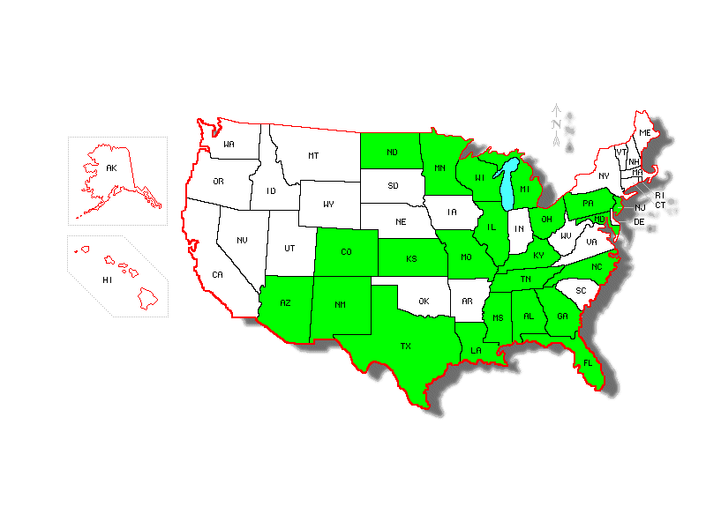
BENEFITS
$10M
$17M
Average Investment
at a typical 10 GW fleet
Average Benefits in replacement
power cost avoidance, revenue
Gained from assets & avoided repairs
Average Payback Period
< 1.5 yrs
Southern Company Generation M&D Center
200,000 MW
Global Capacity under Fleet Wide Monitoring
Notes:
Mention international trend and collaboration – EDF visit
Joe: “FWMIG provides a forum to discuss equipment and data challenges. In addition a place to debate the value of first principles vs. statistics with peers that know what you mean.”

Slide 19
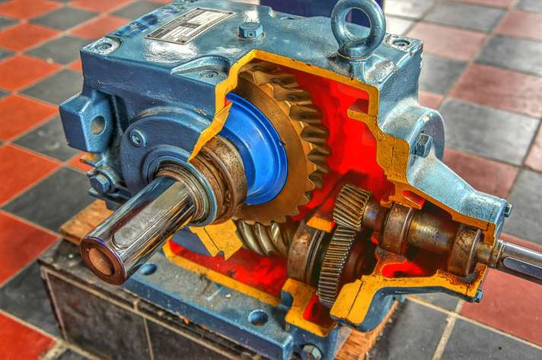
Smart MW- “The Internet of Heavier Things”
Industry transition to smart, connected products– self diagnosing and alerting
Product guarantees replaced with function output guarantees ; e.g. “tons of coal crushed per hour” not coal crusher
Informing up and down the procurement supply chain for positioning contract negotiations and warranties

Slide 20
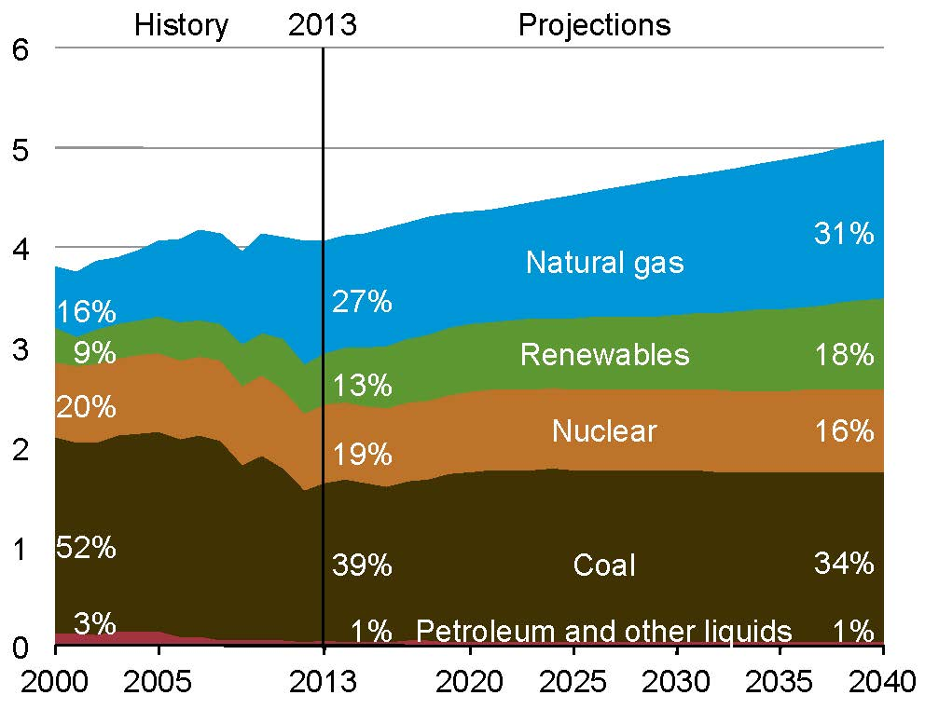
Our Sources of Energy will Change

Slide 21
Levelized Cost of Electricity (LCOE)-2020
Based on 30-year cost recovery, WACC 6.1%. (3% added to WACC for GHG emissions)
DISPATCHABLE

Slide 22
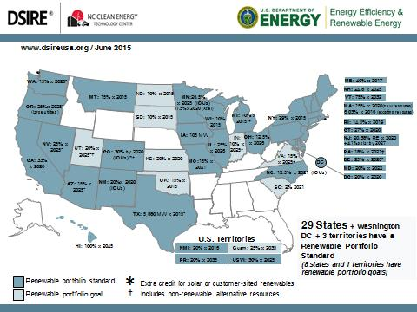
U.S. Renewable Policies

Slide 23
Enormous U.S. Investment Needs
350 TWh green energy from state RPS by 2030 - $120B
New transmission to integrate renewables and maintain reliability- $250B
Decarbonize existing generators - $1,000 B
Aging distribution system with smart grid - $600B

Slide 24
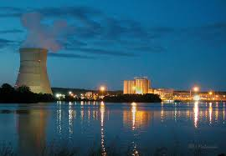
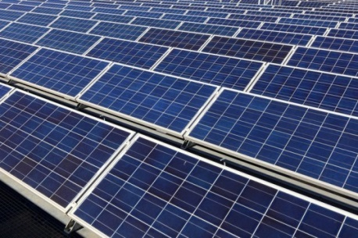
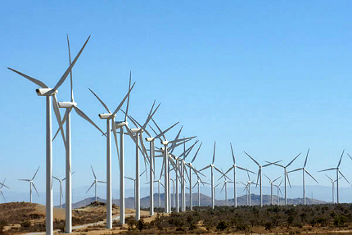
Enormous Land Use Demands
Plant | Name-Plate Capacity /CF | Land Area (Acres) | Acres/ MW
Arkansas Nuclear One | 1,800 MW 90% | 1,100 | <1
Equivalent Solar Plant | 1,800 MW 20% | 13,320 | 8
Equivalent Wind Plant | 1,800 MW 30% | 108,000 | 67
ANO- 1,800 MW
Solar Star – 579 MW
Alta Wind Energy- 1,079 MW

Slide 25
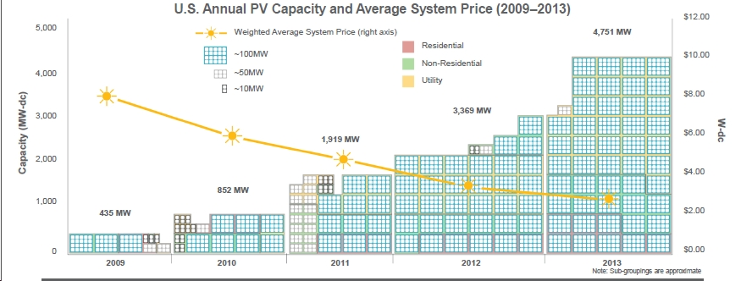
Renewable in the U.S.
2014 - 6,247 MW
2015 - 5,480 MW (Est.)

Slide 26
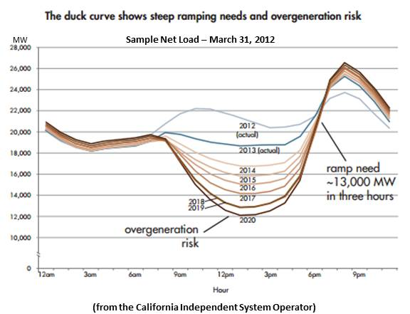
The Duck Curve
CA may be reliant on its neighbor NV for generation support

Slide 27
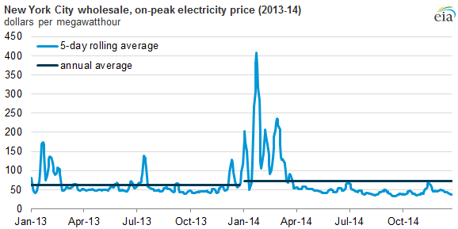
Retail Price Inelasticity
Average Retail Price

Slide 28


Goals in Conflict
Reliable, Cheap, Clean, and Appealing
Fuel | Reliable | Cheap | Clean | Appealing
COAL
NUCLEAR
SOLAR & WIND
NATURAL GAS
HYDRO
THE GRID
BALANCED PORTFOLIO!!

Slide 29
Industry Needs for Near- & Long Term
Increased use of information and operational technologies for immediate line of sight and situational awareness
  Smart Monitoring
  Performance-based procurement
  Integration with social media
Distributed Generation--- Grid Integration, GHG Emission concerns
Grid Modernization
Cybersecurity
Customer-Centric Approach: A Resource for Load Management

Slide 30
Acknowledgments
The Energy Information Agency (EIA) of DOE
EPRI
Scott Madden
Brattle Group
Interview with Matt Wald by EPRI Journal, July 2015
DSIRE- NC Clean Energy Consortium
Discussions with colleagues at TVA, Duke Energy and UNC Charlotte
Greentech Media article on “Germany and Renewables”
Andrea Miksch, Visiting KIT Student at UNC Charlotte EPIC
http://www.utilitydive.com/news/the-top-10-trends-transforming-the-electric-power-sector/405798/

